Slide 1


MANAGEMENT OF HAZARDS IN FOOD
Mary Anupama Palukurty
Assistant Professor,
Dept. of Biochemistry,
St.Joseph’s College for Women (A),
Visakhapatnam

Slide 2
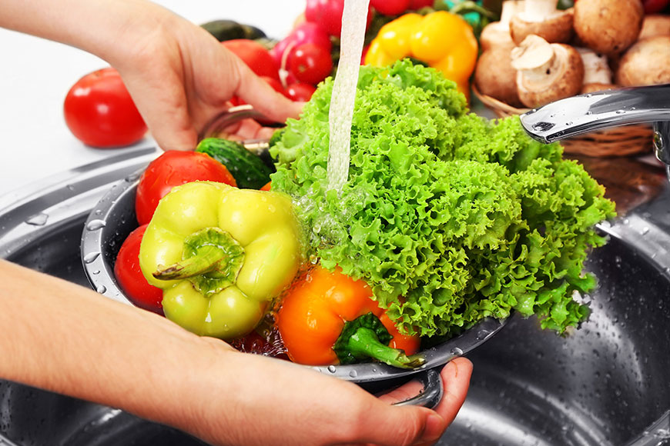
INTRODUCTION
Food Safety and Hygiene becomes an emerging demand in the food industry and is a universal concern. Therefore, maintaining food safety & hygiene is a compelling requisite for food entrepreneurs to sustain in today’s competitive market.

Slide 3
The International Organization for Standardization created ISO 22000 standard to manage food safety and security and specifies the essentials for a food safety management system that involves:
Interactive communication
System management
Prerequisite programs
HACCP principles (Hygiene analysis and critical control points)
The food safety management system identifies, evaluates, and controls food hazards, at all levels of the food supply chain; be it during ingredient supply, food preparation, packaging, storage, transportation, etc.

Slide 4
Food safety and hygiene are crucial to reducing the risk of food-borne illnesses that may cause through biological hazards such as pathogenic bacteria, viruses, and parasites, or chemical hazards or natural toxins.
If the food safety guidelines are not followed precisely, people can fall sick and may even lead to death.
If the food is improperly stored, handled, cooked, or refrigerated, bacteria can grow leading to food contamination.
At times, there would be issues like product recall, where seller may request consumers to return a product after the discovery of any product defects or safety issues that might endanger the consumer or put the seller at risk of legal action
Hence, complying food safety guidelines is essential to maintain the quality as well as the shelf life of the food products.
An effective food safety management system that is based on seven principles of HACCP can help businesses to identify and control hazards before they threaten the safety of your food and customers.

Slide 5
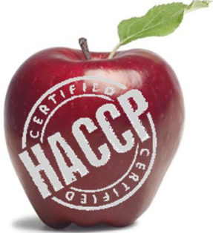
The seven principles of HACCP include
Hazard Analysis
It is a preventive approach to food safety, which identifies biological, chemical, and physical hazards
Critical Control Point (CCP)
These are applied at stages of the process to eliminate or reduce the hazards to an acceptable (critical) level
Critical Limits
The safety limits that determines a maximum and minimum value for each CCP.
Monitoring
. These include observations or measurements to assess whether the CCP is being met

Slide 6
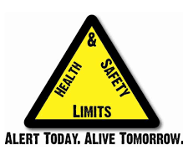
Corrective Action
Actions that need to take if there is any deviation from the established critical limit
Verification
To determine that the food safety management plan is properly implemented and all the hazards were identified
contains complete records & forms to show that checks have been carried out at appropriate intervals in line with the Food Safety Policy
Record Keeping & Documentation

Slide 7
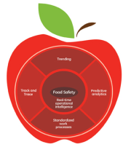
Food safety management tools
Conduct a risk assessment
These provide a basis for determining the need to establish microbiological safety objectives
Establish food safety objectives
It is a statement of the maximum level of a microbiological hazard considered acceptable for consumer protection
Achievable food safe& objectives
objectives should be achievable throughout the food chain
Establish microbiological criteria, when appropriate:
Establish acceptance procedures for the food at port of entry
This must be performed by an expert group of food microbiologists.
A list of approved suppliers as determined by inspection of facilities and operations, certification, microbiological testing

Slide 8
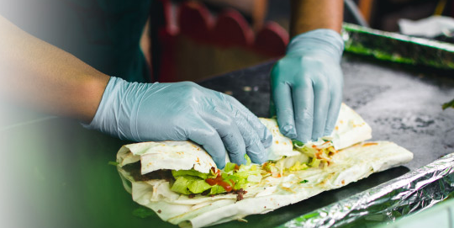
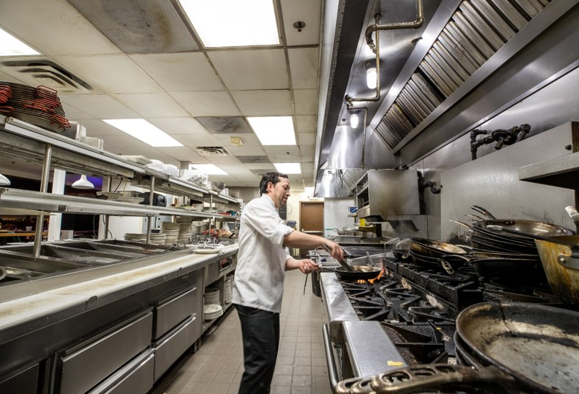
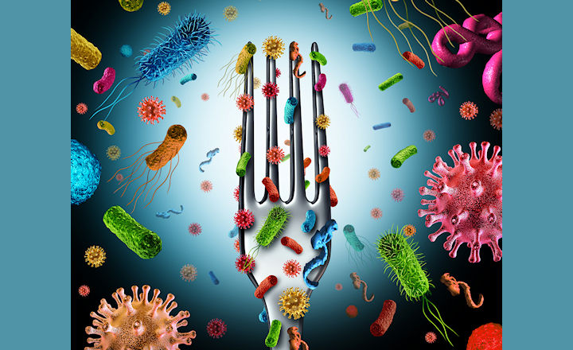
Hazard Analysis Critical Control Point (HACCP)
Most food poisoning can be prevented by the application of the basic principles of food hygiene throughout the food chain. This is achievable through:
(1) Education and training of food handlers and consumers in the application of safe food production practices.
2) Inspection of premises to ensure consistent hygienic practices are adhered to.
3) Microbiological testing for the presence or absence of food borne pathogens and toxins.

Slide 9
Outline of HACCP
Three controlled stages must be established:
(1) Prevent microorganisms from contaminating food through hygienic production measures. This must include an examination of ingredients, premises, equipment, cleaning and disinfection protocols and personnel.
2) Prevent microorganisms from growing or forming toxins in food. This can be achieved through chilling, freezing or other processes such as reduction of water activity or pH. These processes, however, do not destroy microorganisms.
3) Eliminate any food borne microorganisms, for example by using a time and temperature processing procedure or by the addition of suitable preservatives

Slide 10
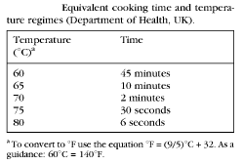
Temperature control of microbiological hazards
Critical Limits of temperature and time can be set, monitored and corrected.
Temperature is to be set to reduce microbial count to less than 10 cells and also kill spores.
A list of time and temperature equivalencies is given in Table below.

Slide 11
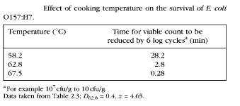
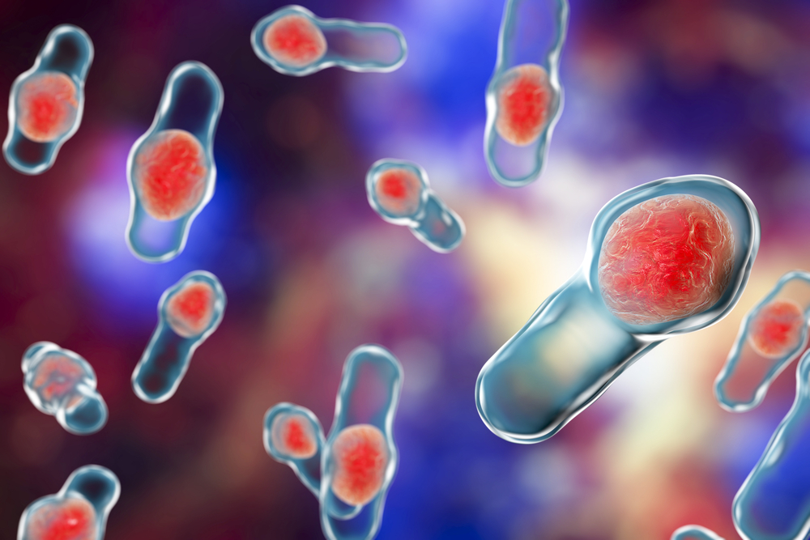
Effect of cooking temperature on the survival of E.coli 0157:H7 is given in Table below
The cooling period must be short enough to prevent spore outgrowth and germination from mesophilic Bacillus and Clostridium spp.
The cooking process would create an anaerobic environment in the food which is ideal for Clostridium spp.

Slide 12
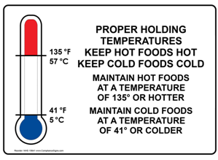
Holding temperatures for food
General recommended holding temperatures are:
Cold served foods < 8°C
Hot served foods > 63°C
Clostridium spp. do not grow below 10°C.
St. aureus produces toxins above 10°C,but multiply till 6ºC.
Temperature abuse can lead to St. aureus growth and toxin production.
These Toxins are not inactivated by reheating to 72ºC,
Chilled foods should be stored below -33°C to assure safety from spore germination and subsequent toxin production by Cl. botulinum .

Slide 13
STORING FOOD
Employees who will be receiving and storing food maintain the storage areas, including dry, refrigerated and freezer storage, by following these steps:
1. Storage Upon Receiving
1. Place foods in the proper storage area to avoid bacterial growth.
41°F or lower – refrigerator temperatures
50° to 70°F at 50 to 60% humidity – dry storage temperatures
0°F or below – freezer temperatures

Slide 14
2. Place foods into appropriate storage areas
Refrigerated foods
Prepared or ready-to-eat foods
Frozen food
Dry foods
Fish and seafood items
Whole cuts of raw beef
Whole cuts of raw pork
Ground or processed meats
Raw poultry

Slide 15
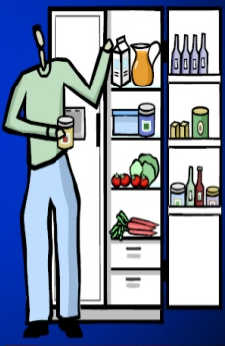
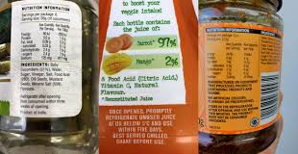
Keep all food items on shelves that are at least 6” above the floor to facilitate air circulation and proper cleaning.
Store food out of direct sunlight.
Use First In First Out (FIFO) rotation of products.
6. Mixing old food with new food is not acceptable.
Make sure items are dated with receiving date and/or use-by date.
Store food in original container if the container is clean, dry, and intact. If necessary, repackage food in clean, well-labeled, airtight containers. This also can be done after a package is opened.
Food is NEVER put in chemical containers and chemicals are NEVER placed in food storage containers.

Slide 16
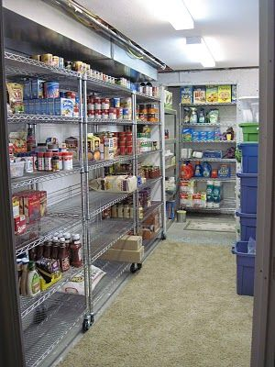
Store room sanitation:
Maintain clean and neat storage areas. They should be away from areas where garbage is stored.
Dispose of items that are beyond the expiration or “use by” dates.
Store all items on shelves at least 6” above the floor to facilitate air circulation and proper cleaning.
Check for signs of rodents or insects. If there are signs of the presence of rodents or insects, notify the maintenance or the person in charge.

Slide 17

Temperature Control:
Check the temperatures of all refrigerators, freezers, and dry storerooms at the beginning of each shift. This includes both internal and external thermometers.
Record cold storage unit temperatures on the appropriate temperature log.
Notify designated person immediately of any unacceptable temperatures.
Limit overloading refrigerated storage areas, as this prevents air flow and makes the unit work harder to stay cold.
Use caution when cooling hot food in the refrigerator, as this warms the unit and can put other foods into the temperature danger zone.
Keep units closed.
Defrost all units on a regular schedule .

Slide 18


MONITORING AND RECORD KEEPING:
Designated person will keep logs for all cold storage units.
Temperature logs will be reviewed by person in charge to make sure there are no temperature deviations and necessary corrective action was taken.
Follow up on all reported problems.
Monitoring logs will be kept: Minimum required by federal regulation (a period of six months following a month’s temperature records)
CORRECTIVE ACTION:
Discard any potentially (Time/Temperature Control for Safety Food) stored at conditions that render the product unsafe to eat. Re-train employees or volunteers.

Slide 19
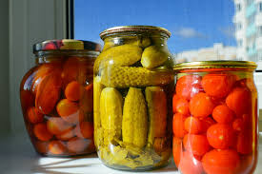
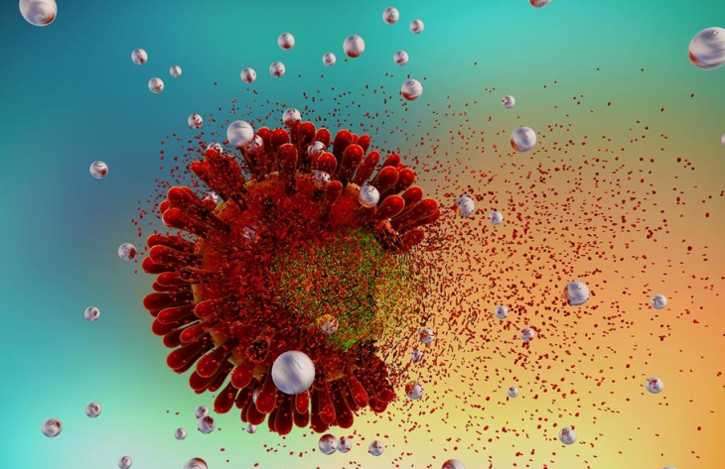
PHYSICAL METHODS TO CONTROL MICROORGANISMS
Various physical methods of microbial control for food preservation.
Common control methods include the application of high temperatures, radiation, filtration, and desiccation (drying), among others.
Many of these methods nonspecifically kill cells by
-disrupting membranes,
- changing membrane permeability,
- damaging proteins and
- nucleic acids by denaturation,
- degradation, or chemical modification.

Slide 20
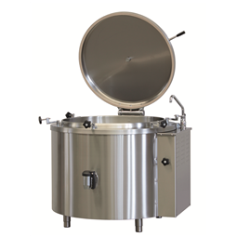
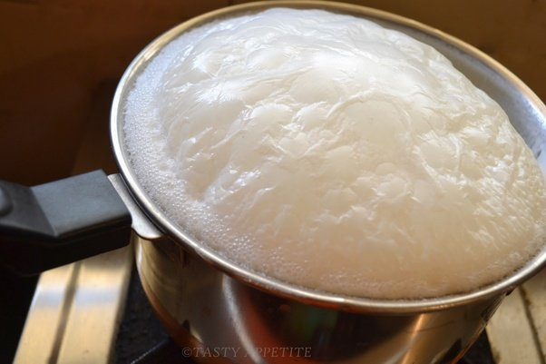
Heat
Heating is one of the most common—and oldest—forms of microbial control.
It is used in simple techniques like cooking and canning.
Kills microbes by altering their membranes and denaturing proteins.
The thermal death point (TDP) of a microorganism is the lowest temperature at which all microbes are killed in a 10-minute exposure or it is the length of time needed to kill all microorganisms in a sample at a given temperature.
Includes sterilization procedures that use high heat, such as
autoclaving.
boiling is less effective (endospores up to 20 hours of boiling).

Slide 21
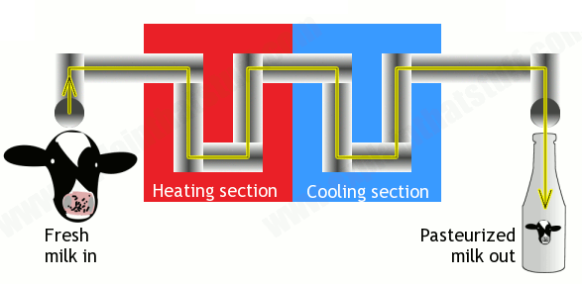
Pasteurization
Pasteurization is a form of microbial control for food that uses heat but does not render the food sterile. Traditional pasteurization kills pathogens and reduces the number of spoilage-causing microbes while maintaining food quality.
First developed by Louis Pasteur in the 1860s as a method for preventing the spoilage of beer and wine. Today, pasteurization is used to kill heat-sensitive pathogens in milk and other food products (e.g., apple juice and honey).
The methods used for milk pasteurization balance the temperature and the length of time of treatment.
High-temperature short-time (HTST) pasteurization, exposes milk to a temperature of 72 °C for 15 seconds ( Used of milk)
Ultra-high-temperature (UHT) pasteurization, in which the milk is exposed to a temperature of 138 °C for 2 or more seconds. Helps tostore milk for longer duration without refrigeration. Dis adv. alters the proteins in the milk, causing slight changes in the taste and smell.

Slide 22
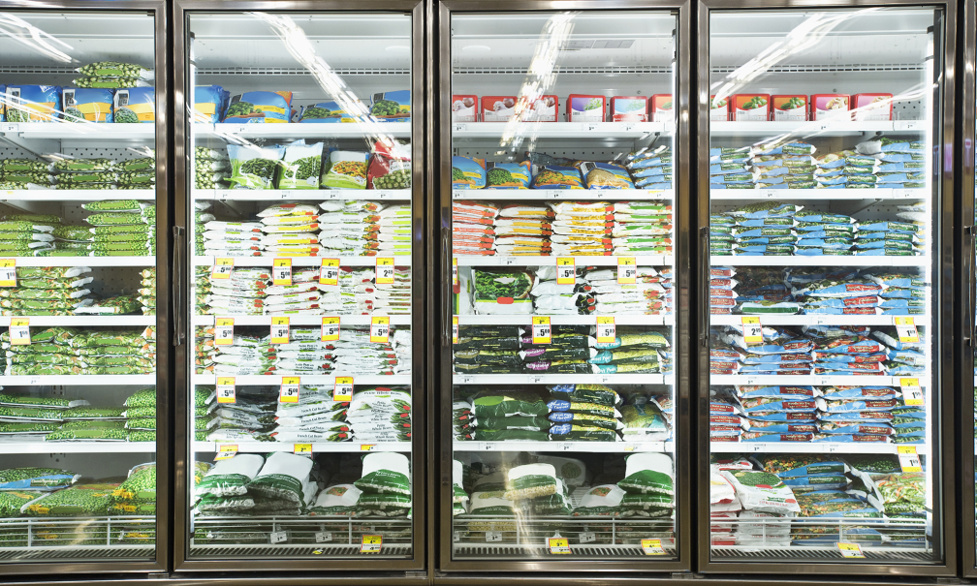
Refrigeration and Freezing
Exposing microbes to low temperatures can be an easy and effective method of microbial control, with the exception of psychrophiles, which prefer cold temperature
Refrigerators used in home kitchens or in the laboratory maintain temperatures between 0 °C and 7 °C. This temperature inhibits microbial metabolism, slowing the growth of microorganisms significantly
Freezing below −2 °C may stop microbial growth and even kill susceptible organisms.
According to the US Department of Agriculture (USDA), the only safe ways that frozen foods can be thawed are in the refrigerator, immersed in cold water changed every 30 minutes, or in the microwave, keeping the food at temperatures not conducive for bacterial growth.
In addition, halted bacterial growth can restart in thawed foods, so thawed foods should be treated like fresh perishables.

Slide 23
Pressure
Exposure to high pressure kills many microbes (pressure between 100 and 800 MPa ).
In the food industry, high-pressure processing (called pascalization) is used to kill bacteria, yeast, molds, parasites, and viruses in foods while maintaining food quality and extending shelf life.
It kills vegetative cells by protein denaturation, but endospores may survive these pressures.
Desiccation
Drying, also known as desiccation or dehydration.
Used to preserve foods such as raisins, prunes, and jerky.
Microbes, require water for their metabolism and survival., hence their growth is halted.
It does not kill all microbes or their endospores.
In some cases, foods are dried in the sun, relying on evaporation to achieve desiccation.

Slide 24
Freeze-drying, or lyophilization:
It is rapid frozen method. Samples are placed under vacuum so that water is lost by sublimation.
Procedure combines both exposure to cold temperatures and
Helps in controlling microbial growth.
Lyophilized items may be stored at room
in the food industry and is also used in the laboratory for the long-term storage and transportation of microbial cultures.
Many microorganisms do not survive hyper osmotic conditions. Honey, for example, is 80% sucrose, an environment in which very few microorganisms are capable of growing, thereby eliminating the need for refrigeration.
Salted meats and fish, Fruits were preserved by adding sugar, making jams and jellies.
Mold may attach this food

Slide 25

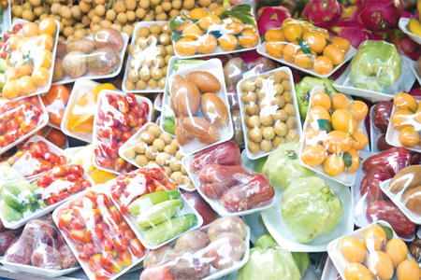
Radiation
High-energy radiation can be used to kill microbes or inhibit their growth. Ionizing radiation includes X-rays, gamma rays, and high-energy electron beams.
Ionizing radiation pass into the cell, where it alters molecular structures and damages cell components. For example, ionizing radiation effect double-strand breaks in DNA molecules, cause DNA mutations.
X-rays and gamma rays penetrate paper and plastic and hence used to sterilize many packaged materials.
Packaged dried spices are also often gamma-irradiated.
They penetrate paper, plastic, thin sheets of wood and metal, and tissue.
Nonionizing radiation, is Ultraviolet (UV) light ; it causes thymine dimers to form between adjacent thymines within a single strand of DNA which leads to formation of mutations that can ultimately kill microorganisms.
UV lamps are now commonly incorporated into water purification systems. Gamma irradiation safe and effective for various types of meats, poultry, shellfish, fresh fruits and vegetables, eggs with shells, and spices and seasonings

Slide 26
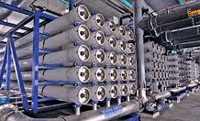
Membrane Filters
Filtration can also be used to remove microbes from water using membrane filtration.
Membrane filters for liquids as they have small pores that filter out microorganisms. Typically, membrane filters that are used to remove bacteria have an effective pore size of 0.2 µm, smaller than the average size of a bacterium (1 µm),

Slide 27
Waste Management in Food Industry
Large amounts of food is wasted throughout the food supply chain- in production, during distribution and sale of food products.
According to the Food and Agriculture Organization (FAO), annually one third of the food produced in the world for human consumption gets lost or wasted.
In developing countries and industrialized areas food losses mainly occur in initial agricultural production. Due to poor agriculture and natural resource management, unfavorable climatic conditions.
Significant amount of unnecessary loss can be avoided with better management systems throughout the food supply chain.
The internationally accepted approach of waste management hierarchy helps food establishments to prioritize waste management practices in order to handle waste in a sustainable manner.

Slide 28
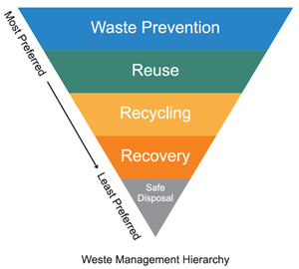

Slide 29
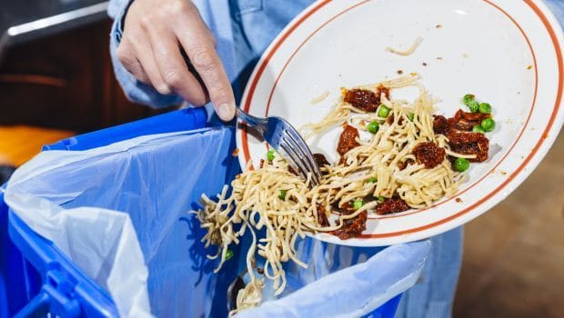
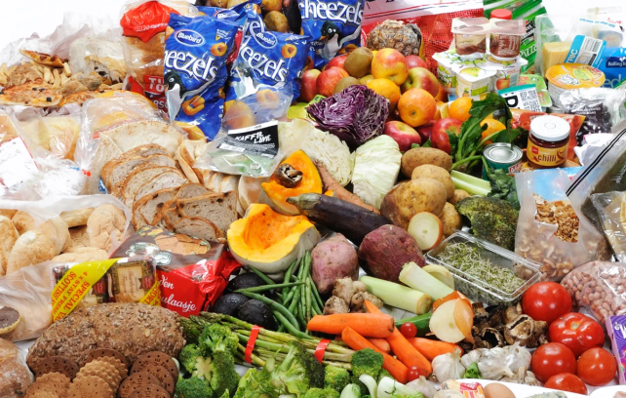
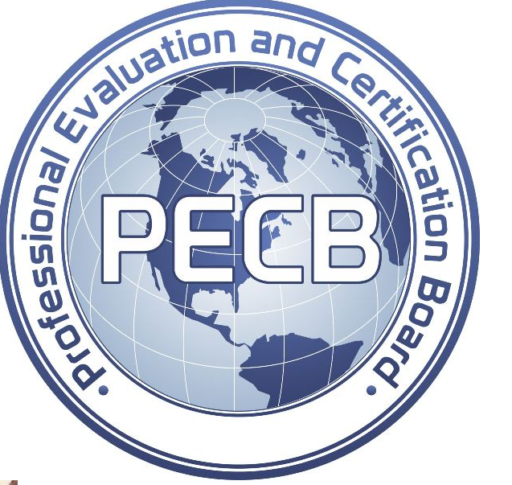
The simplest and the most preferable practice is prevention of waste at the source.
Land filling is the least preferable waste management option
When food is wasted all of the natural resources that were expended in the supply chain are also lost (land, water and energy).
The impact that food waste have on environment and society is bitterer. Broad-scale effects of food wastage contribute to global environmental problems such as pollution and climate change.
International Organization for Standardization (ISO) developed a numerous international standards which help organizations to improve their management systems and optimize their processes related to quality (ISO 9001), environment (ISO 14001), energy (ISO 50001) etc
Professional Evaluation and Certification Board (PECB) and ISO 14001 training and certification services for professionals.

Slide 30
ISO 14001 and Environment Trainings offered by PECB:
Certified ISO 14001 Lead Implementer (5 days)
Certified ISO 14001 Lead Auditor (5 days)
Certified ISO 14001 Foundation (2 days)
ISO 14001 Introduction (1 day)

Slide 31
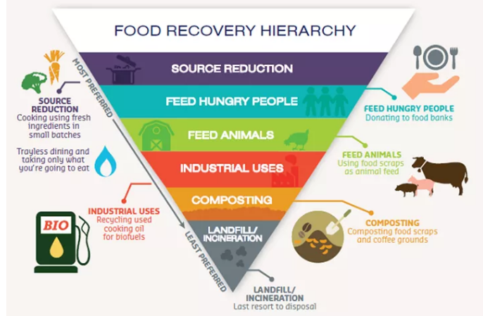
EPA’s Food Recovery Hierarchy
It provides the guidance to start a program that will provide the most benefits for the environment, society and the food manufacturer.

Slide 32
PEST MANAGEMENT STANDARDS
Food safety audits may be carried out by auditors from within the company or from an independent organization.
The audit is based on a series of criteria set to ensure the highest standard of compliance with a specific aspect of food safety.
The section which deals with pest management will usually require zero infestation and conformity with criteria covering type of pest management programme; permitted materials and techniques and record keeping.
Care is essential when setting criteria to ensure that they achieve the required result.
Over –prescriptive criteria may place unnecessary restrictions on the pest management programme, extending the period before control is achieved.

Slide 33
Risk-based standards
If aim is to reached, best practice suggested must be practical and flexible.
The standard should be risk-based in order to address the issues raised by the following:
Risk to public health due to activities of pests: These carry a range of pathogens which can be transmitted to humans either through contaminated food or their presence in the environment. Risk to food safety This will be the priority for all engaged in the production, storage, transport, processing and sale of food. The risks include:
• Physical contamination of product by rodent droppings, insect parts or other foreign bodies
• Introduction of micro organisms
• Damage to product or packaging
Risk to public safety and the environment: The irresponsible or inaccurate use of pesticides may present a hazard to technicians, site staff and members of the general public, as well as to the environment through contamination of water, damage to plants and the effect on non-target species of animals.

Slide 34
Environmental management and pesticide reduction: These relie on environmental management and inspection of the site to reduce the attraction to pests.
Pest management programmes aim to reduce the use of pesticides, particularly outdoors, based on proofing and hygiene.
For example, reliance on toxic rodent baits outdoors as a permanent indicator of rat activity is no longer acceptable.
Pest Awareness and Staff Training: Training of appropriate personnel concerned and departmental personnel on pest prevention. Particular attention should be given to incoming goods such as raw materials or packaging.
Pests and their habits: Training on the identification and habits of the more common pests of the food industry can be given by the pest control contractor or through independent consultants.
Pest prevention: The importance of pest prevention through good hygiene, stock management and exclusion practices should be emphasized. Site personnel have the day to day responsibility of ensuring a pest management programme is maintained.

Slide 35
Pest control report: Inspection reports must be concise and legible and stored in an easily accessible binder. A typical pest control report will contain as a minimum:
• Treatment date
• Details of the pest control contractor and name of technician servicing the site
• Details of the customer and name of the contact person on site
• Type of visit: scheduled, follow-up, callout, etc
• Pests found
• Action taken
• Pesticide used
• Location of baits and monitors (this may be in the form of a checklist or plan)
• Quantities used
• Risk assessment
• Post treatment precautions
• Recommendations on proofing, hygiene and storage
• Details of follow-up inspections

Slide 36
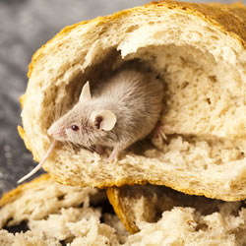
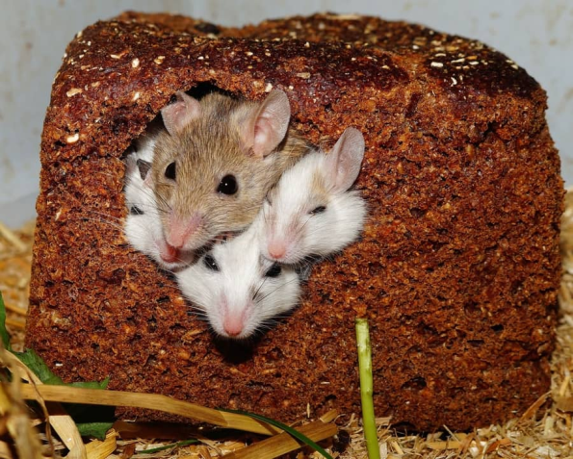
Rodent Management
- Commensal rodents can cause damage to stored grain and structures.
- Good sanitation practices, combined with steps to prevent rodent entry into structures and the elimination of rodent harborage, will reduce rodent problems.
Sanitation and Habitat Modification : Clean, orderly facilities will not support large numbers of rodents. Attention to key elements that rodents require for survival, food and shelter, is important in limiting the habitat’s carrying capacity for these species.
Rats cannot survive in water free area
Regular cleaning creates stress on rats
Sanitation involves good housekeeping, including proper storage and handling of food materials. Warehouses, processing areas, packaging areas and similar structures may provide excellent habitat for commensal rodents.
-- Finished products should be stored in rodent proof structures whenever possible.
- Racks should hold stacked lumber, building supplies, rubbish, etc,. at least 18 inches (45 cm) off the ground.

Slide 37
Importance of Personal Hygiene
It is imperative for safe food-handling outcomes for all workers to be familiar with standard sanitation and hygiene practices.
Figure below shows the cycles of transmission of micro-organisms.
One of the basic principles is to break the cycle by avoiding cross-contamination, which can be achieved by ensuring personal hygiene practices are followed:
Food handler
Environment
Food

Slide 38


Proper personal hygiene is critical in any food service premise.
Personal hygiene includes:
• Showering and bathing regularly
• Keeping hair clean hair and covered or tied back
• Keeping clean clothing and footwear that is used only at work
• Hand washing regularly • Using clean utensils for tasting food
• Using separate cloths for cleaning and wiping plates
Hand washing Proper and regular hand washing is a critical part of any food safety system.
one must always wash hands after:
• Sneezing, coughing, or touching your mouth or nose
• Using the bathroom
• Smoking or using toothpicks
• Handling raw foods
• Cleaning and wiping tables, food preparation surfaces, or equipment
• Handling soiled objects, garbage, or money

Slide 39
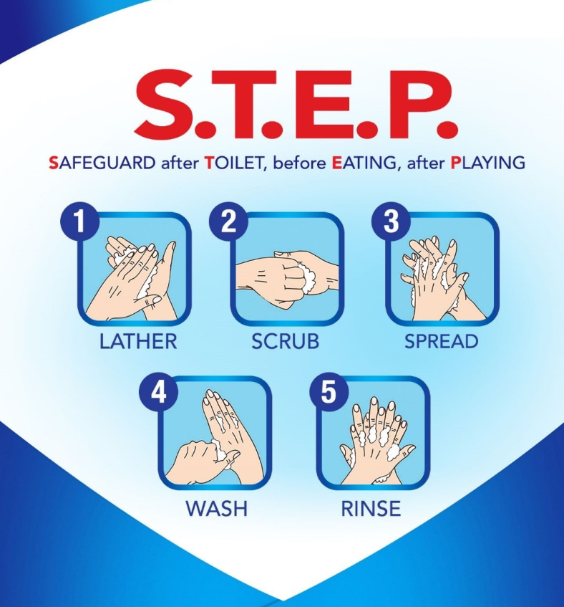
The steps for proper hand washing are as follows:
1. Wet hands with warm water.
2. Apply liquid soap and lather for at least 20 to 30 seconds.
3. Scrub backs of hands, wrists, all fingers, and under nails.
4. Rinse under running water, pointing down toward the drain.
5. Dry with a paper towel.
6. Turn off taps and open bathroom door using the paper towel

Slide 40
THANK YOU
FOR YOUR
PATIENT HEARING
Dr. ANUPAMA, SJC

